Slide 1
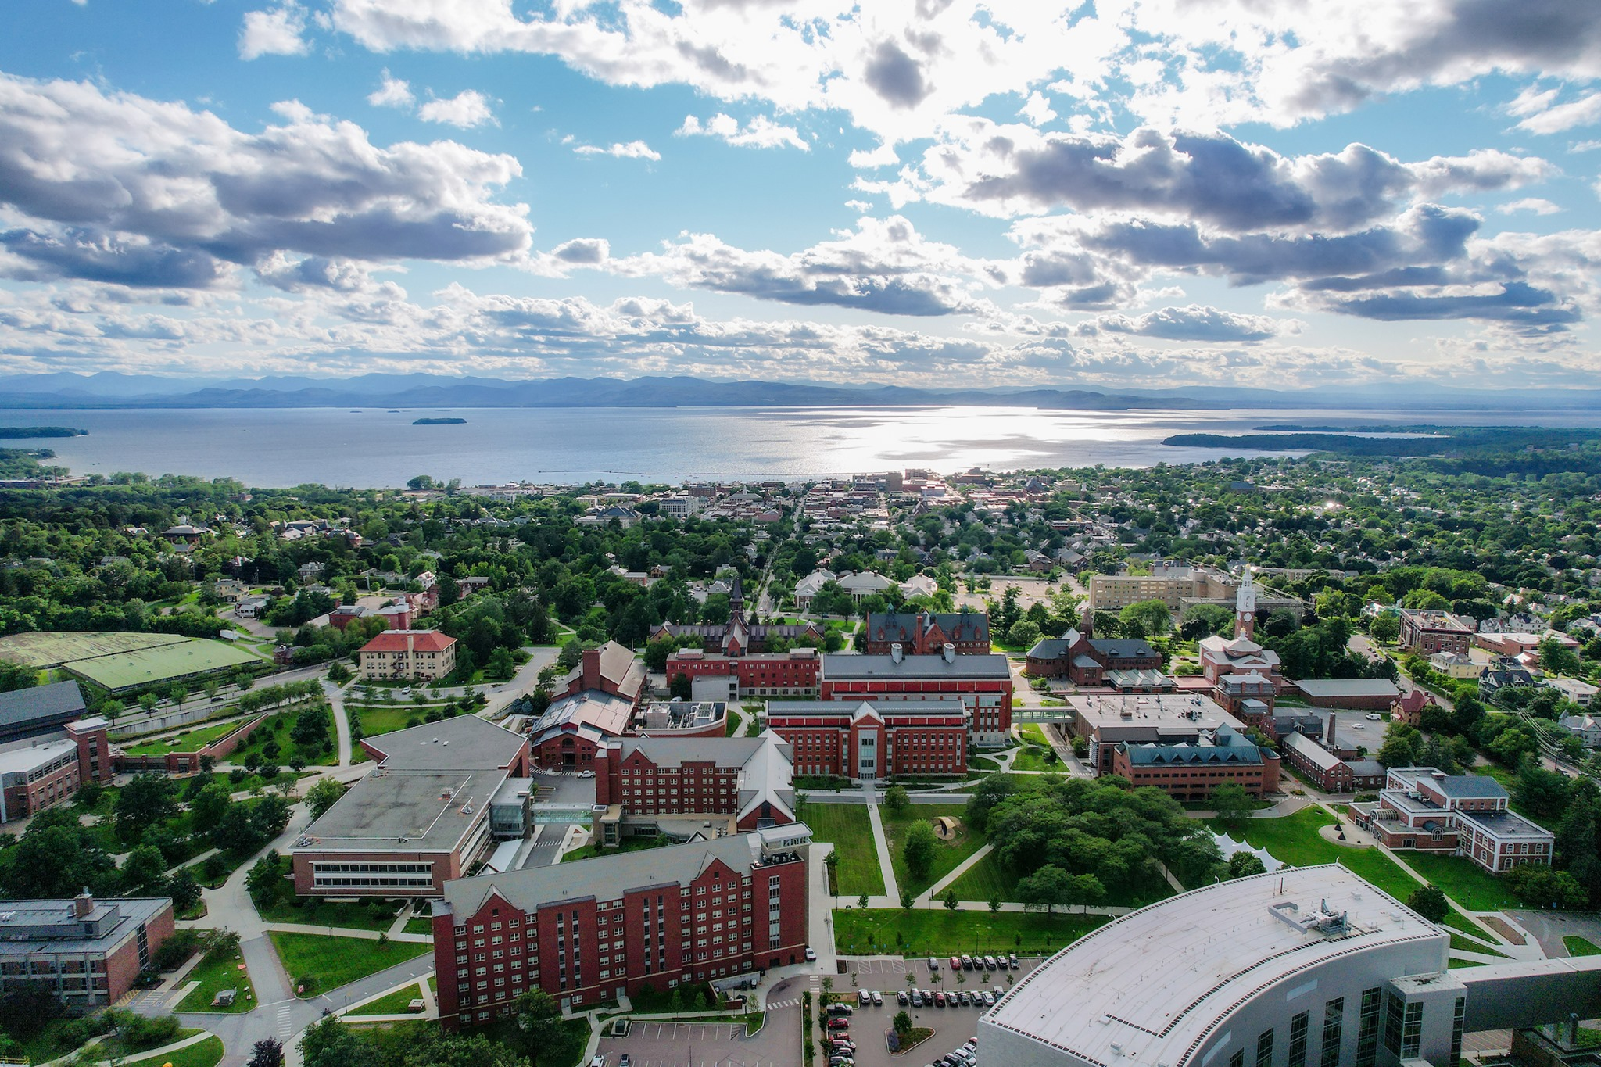


CCSS 2023
Contagion on Complex Social Systems workshop
August 14-16, 2023
Burlington, Vermont

